Slide 1
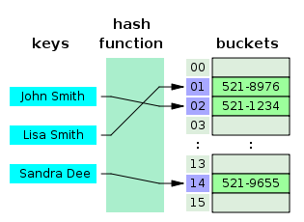
COSC 222 Data Structures
Yves Lucet
Shiyu Ji, CC BY-SA 4.0, via Wikimedia Commons
"Hash table 3 1 1 0 1 0 0 SP" by Jorge Stolfi - Own work. Licensed under CC BY-SA 3.0 via Commons - https://commons.wikimedia.org/wiki/File:Hash_table_3_1_1_0_1_0_0_SP.svg#/media/File:Hash_table_3_1_1_0_1_0_0_SP.svg
CC BY-SA 3.0 https://en.wikipedia.org/wiki/Skip_list#/media/File:Skip_list_add_element-en.gif

Slide 2
Wk | Class | Date | Activity | Reading/Prep given | Peer
1 |  | Sep 04 | NO CLASS
 | 1 | Sep 06 | blacklists, Syllabus, TBL | Java, Generics, Testing
2 | 2 | Sep 11 | RAT1: generics; unit testing | Complexity
 | 3 | Sep 13 | Lect: Complexity, streams | Lists
3 | 4 | Sep 18 | Build & Critic (training) | iMAT1
 | 5 | Sep 20 | tMAT1 | Recursion
4 | 6 | Sep 25 | RAT2 | Stack, Queue | Peer 1
 | 7 | Sep 27 | Build & Critic | Iterators
5 | 8 | Oct 02 | mini-lecture+exercises | iMAT2
 | 9 | Oct 04 | tMAT2 | BST, PQ, heap
6 | 10 | Oct 09 | RAT3 | Hash, skip list | Peer 2
 | 11 | Oct 11 | Hash table, Skiplist, ex. | 14.6 Shortest path
7 | 12 | Oct 16 | Dijsktra+Competition ex. | Union-find
 | 13 | Oct 18 | Union-find/Disjoint sets | iMAT3
8 | 14 | Oct 23 | tMAT3 | Search Trees AVL/RB
 | 15 | Oct 25 | Lecture |  | Peer 3
9 | 16 | Oct 30 | Midterm review
 | 17 | Nov 01 | Midterm
10 | 18 | Nov 06 | RAT4 | B-Trees
 | 19 | Nov 08 | Exercise: Select tree | iMAT4
11 | 20 | Nov 13 | tMAT4 | Text processing
 | 21 | Nov 15 | Lecture | KMP, BM
12 | 22 | Nov 20 | RAT5 | Tries
 | 23 | Nov 22 | Huffman coding | iMAT5
13 | 24 | Nov 27 | tMAT5 |  | Peer 4
 | 25 | Nov 29 | Review/Course Evaluation

Slide 3
Union-Find aka Disjoint-set Partition Structures
Motivation: Kruskal’s algorithms need to maintain a partition

Slide 4
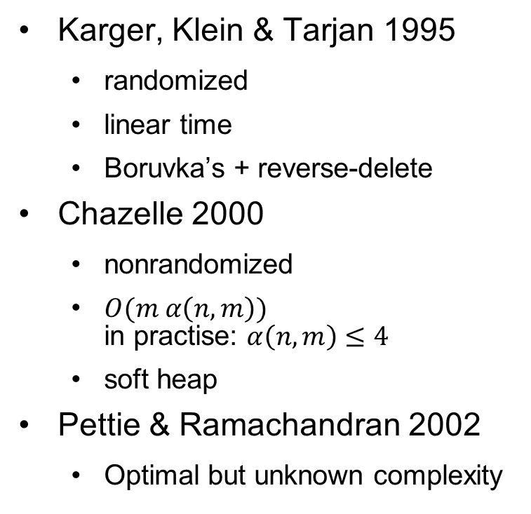
History of Minimum Spanning Trees
History
Fastest
Boruvka’s 1926
Choquet 1938, Florek et al. 1951, Sollin 1965
Prim’s 1930
Jarnik; Prim 1957, Dijkstra 1959
Kruskal’s 1956
Reverse-delete
Kruskal 1956
Karger, Klein & Tarjan 1995
randomized
linear time
Boruvka’s + reverse-delete
Chazelle 2000
nonrandomized
$O(m α\left(n,m\right))$ in practise: $α\left(n,m\right)≤4$
soft heap
Pettie & Ramachandran 2002
Optimal but unknown complexity
https://en.wikipedia.org/wiki/Minimum_spanning_tree#Classic_algorithms
Notes:
alpha is the classical functional inverse of the Ackermann function, https://en.wikipedia.org/wiki/Ackermann_function#Inverse

Slide 5
Other Minimum Spanning Tree Algorithms
Prim’s
start from one node
grow cloud by one node with smaller weight
similar to Dijkstra
Kruskal’s
start with all nodes as spanning trees
merge 2 spanning trees by one edge with lowest weight provided that does not create a cycle
Reverse-delete
start from full graph
delete edge with largest weight unless it disconnects the graph
loop till all edges considered

Slide 6
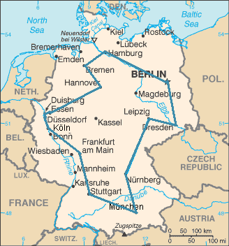
MST application
Travelling salesman: given a list of cities and their connections, visit each city only once, go back to your starting city and minimize the distance travelled.
Optimal route of a salesman visiting the 15 biggest cities in Germany. The route shown is the shortest of the 43,589,145,600 possible ones.
By The original uploader was Kapitän Nemo at German Wikipedia. - https://www.cia.gov/cia/publications/factbook/maps/gm-map.gif, Public Domain, https://commons.wikimedia.org/w/index.php?curid=5584283

Slide 7
Travelling salesman
Problem is hard but…
Can get a lower bound using MST
Can estimate the distance to the best solution

Slide 8
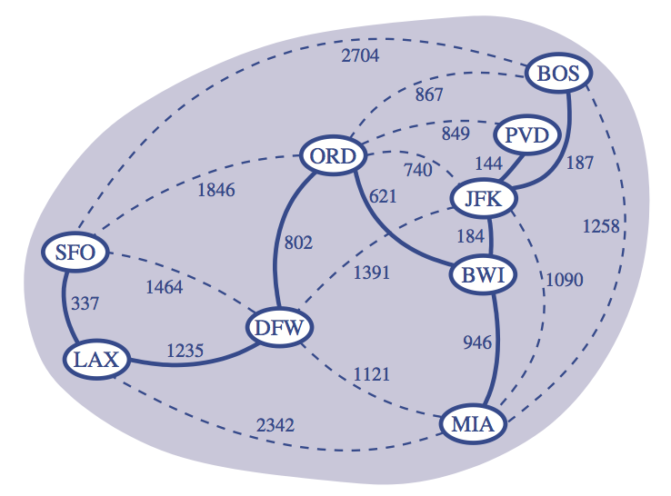
Minimum Spanning Trees
Notes:
Slides from textbook Data Structures and Algorithms in Java, 6th edition, by M. T. Goodrich, R. Tamassia, and M. H. Goldwasser, Wiley, 2014

Slide 9
Minimum Spanning Trees
Spanning subgraph
Subgraph of a graph G containing all the vertices of G
Spanning tree
Spanning subgraph that is itself a (free) tree
Minimum spanning tree (MST)
Spanning tree of a weighted graph with minimum total edge weight
Applications
Communications networks
Transportation networks
ORD
10
1
PIT
DEN
6
7
9
3
DCA
4
STL
8
5
2
DFW
ATL

Slide 10
Cycle Property
Cycle Property:
Let T be a minimum spanning tree of a weighted graph G
Let e be an edge of G that is not in T and let C be the cycle formed by e with T
For every edge f of C, weight(f) ≤ weight(e)
Proof:
By contradiction
If weight(f) > weight(e) we can get a spanning tree of smaller weight by replacing e with f
f
8
4
C
9
2
6
3
e
8
7
7
Replacing f with e yields a better spanning tree
f
8
4
C
9
2
6
3
e
8
7
7

Slide 11
Partition Property
U
V
f
7
Partition Property:
Consider a partition of the vertices of G into subsets U and V
Let e be an edge of minimum weight across the partition
There is a minimum spanning tree of G containing edge e
Proof:
Let T be an MST of G
If T does not contain e, consider the cycle C formed by e with T and let f be an edge of C across the partition
By the cycle property, weight(f) ≤ weight(e)
Thus, weight(f) = weight(e)
We obtain another MST by replacing f with e
4
9
2
5
8
8
e
3
7
Replacing f with e yields another MST
U
V
f
7
4
9
2
5
8
8
e
3
7

Slide 12
Prim-Jarnik’s Algorithm
Similar to Dijkstra’s algorithm
We pick an arbitrary vertex s and we grow the MST as a cloud of vertices, starting from s
We store with each vertex v label d(v) representing the smallest weight of an edge connecting v to a vertex in the cloud
At each step:
We add to the cloud the vertex u outside the cloud with the smallest distance label
We update the labels of the vertices adjacent to u

Slide 13
Example
∞
7
2
7
D
2
7
D
B
4
B
4
8
9
∞
5
9
∞
2
5
F
2
5
F
C
8
C
8
8
3
8
3
E
E
A
7
7
A
7
7
0
0
7
7
2
7
D
7
D
B
4
2
B
4
5
9
∞
9
4
2
5
F
5
5
C
2
F
8
C
8
8
3
3
E
8
A
7
E
0
7
A
7
7
0

Slide 14
Example (contd.)
7
2
7
D
B
4
5
9
4
2
5
F
C
8
8
3
E
A
7
3
7
0
7
D
2
B
4
5
9
4
2
5
F
C
8
8
3
E
A
7
3
0

Slide 15
Analysis
Graph operations
We cycle through the incident edges once for each vertex
Label operations
We set/get the distance, parent and locator labels of vertex z O(deg(z)) times
Setting/getting a label takes O(1) time
Priority queue operations
Each vertex is inserted once into and removed once from the priority queue, where each insertion or removal takes O(log n) time
The key of a vertex w in the priority queue is modified at most deg(w) times, where each key change takes O(log n) time
Prim-Jarnik’s algorithm runs in O((n + m) log n) time provided the graph is represented by the adjacency list structure
Recall that Σ_{v} deg(v) = 2m
The running time is O(m log n) since the graph is connected

Slide 16
Kruskal’s Approach
Maintain a partition of the vertices into clusters
Initially, single-vertex clusters
Keep an MST for each cluster
Merge “closest” clusters and their MSTs
A priority queue stores the edges outside clusters
Key: weight
Element: edge
At the end of the algorithm
One cluster and one MST

Slide 17
Example
G
G
B
8
8
4
B
4
9
E
6
9
E
6
1
5
F
1
5
F
C
11
3
C
11
3
2
2
7
D
H
7
H
A
D
10
A
10
G
G
B
8
B
8
4
4
9
E
6
9
E
6
1
5
F
1
5
F
C
11
3
C
11
3
2
2
7
D
H
7
H
D
A
10
A
10

Slide 18
Example (contd.)
G
G
B
8
8
4
B
4
9
E
6
9
E
6
1
5
F
1
5
F
C
11
3
C
11
3
2
2
7
D
H
7
H
D
A
10
A
10
four steps
two steps
G
G
B
8
B
8
4
4
9
E
6
9
E
6
1
5
F
1
5
F
C
11
3
C
11
3
2
2
7
D
H
7
D
H
A
10
A
10
https://cmps-people.ok.ubc.ca/ylucet/DS/Kruskal.html

Slide 19
Data Structure for Kruskal’s Algorithm
The algorithm maintains a forest of trees A forest is a disjoint union of trees
A priority queue extracts the edges by increasing weight
An edge is accepted it if connects distinct trees
We need a data structure that maintains a partition, i.e., a collection of disjoint sets, with operations:
makeSet(u): create a set consisting of u
find(u): return the set storing u
union(A, B): replace sets A and B with their union
Notes:
A forest is a disjoint union of trees.

Slide 20
Union-Find Partition Structures
Motivation: Kruskal’s algorithms need to maintain a partition
Notes:
11:20

Slide 21
Partitions with Union-Find Operations
makeSet(x): Create a singleton set containing the element x and return the position storing x in this set
union(A, B): Return the set A U B, destroying the old A and B
find(p): Return the set containing the element at position p

Slide 22
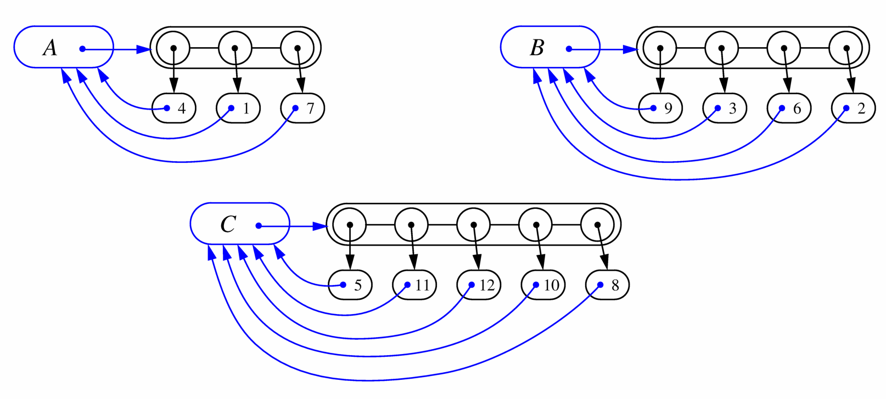
List-based Implementation
Each set is stored in a sequence represented with a linked-list
Each node should store an object containing the element and a reference to the set name

Slide 23

Analysis of List-based Representation
Total time needed to do n unions and finds is O(n log n)
Union or find take $O(\log{n)}$ on average

Slide 24
Tree-based Implementation
Each element is stored in a node, which contains a pointer to a set name
A node v whose set pointer points back to v is also a set name
Each set is a tree, rooted at a node with a self-referencing set pointer
For example: The sets “1”, “2”, and “5”:
1
2
5
4
7
3
6
8
10
9
11
12

Slide 25
Union-Find Operations
5
To do a union, simply make the root of one tree point to the root of the other
To do a find, follow set-name pointers from the starting node until reaching a node whose set-name pointer refers back to itself
2
8
10
3
6
11
9
12
5
2
8
10
3
6
11
9
12

Slide 26
Union-Find Heuristic 1
Union by size:
When performing a union, make the root of smaller tree point to the root of the larger
Implies O(n log n) time for performing n union-find operations:
Each time we follow a pointer, we are going to a subtree of size at least double the size of the previous subtree
Thus, we will follow at most O(log n) pointers for any find.
5
2
8
10
3
6
11
9
12

Slide 27
Union-Find Heuristic 2
Path compression:
After performing a find, compress all the pointers on the path just traversed so that they all point to the root
Implies O(n log* n) time for performing n union-find operations:
Proof is somewhat involved… (and not in the book)
5
5
8
10
8
10
11
11
2
12
2
12
3
6
3
6
9
9
Notes:
log* is the iterated logarithm: number of times the logarithm function must be iteratively applied before the result is less than or equal to 1
log * 16 = 3, log* 65536=4, log * 2^65536 = 5. In practice, log * n can be assumed to be bounded by 5
Only commonly used function that grows slower is the inverse Ackermann function
https://en.wikipedia.org/wiki/Iterated_logarithm

Slide 28
Array-based implementation
https://cmps-people.ok.ubc.ca/ylucet/DS/DisjointSets.html

Slide 29

Complexity
1964 Galler & Fischer
1973 Hopcroft & Ullman $O(\log^{∗}{n})$
https://en.wikipedia.org/wiki/Disjoint-set_data_structure

Slide 30
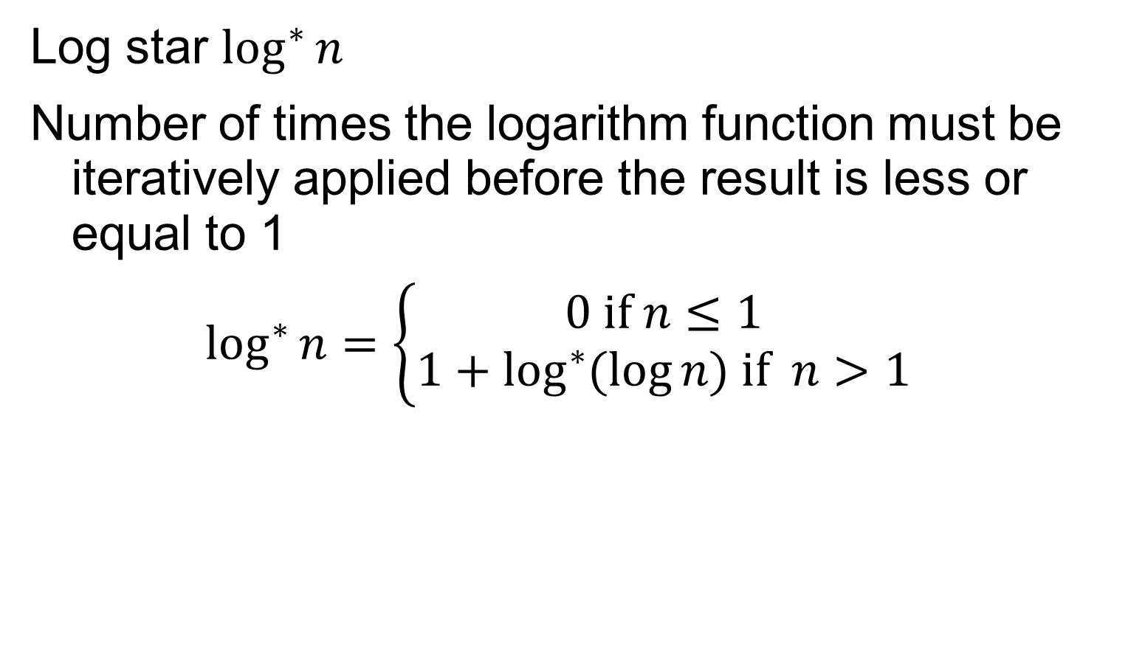
Iterated logarithm
Log star $\log^{∗}{n}$
Number of times the logarithm function must be iteratively applied before the result is less or equal to 1
$$\log^{∗}{n=\left\{\begin{matrix}0 if n≤1 \\ 1+\log^{∗}{(\log{n) if n>1}}\end{matrix}\right.}$$
x | lg* x
(−∞, 1] | 0
(1, 2] | 1
(2, 4] | 2
(4, 16] | 3
(16, 65536] | 4
(65536, 2⁶⁵⁵³⁶] | 5
https://en.wikipedia.org/wiki/Iterated_logarithm

Slide 31

Complexity
1964 Galler & Fischer
1973 Hopcroft & Ullman $O(\log^{∗}{n})$
1975 Tarjan $O(m α\left(n\right))$
https://en.wikipedia.org/wiki/Disjoint-set_data_structure

Slide 32
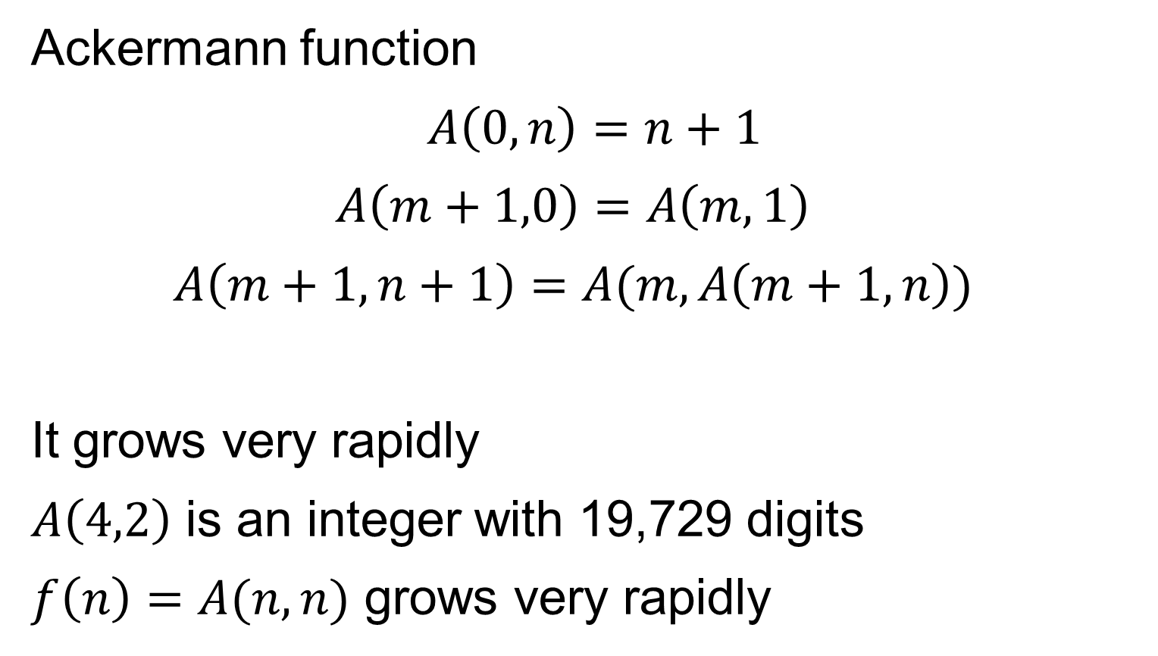
Inverse Ackermann function
Ackermann function
$$A\left(0,n\right)=n+1$$
$$A\left(m+1,0\right)=A\left(m,1\right)$$
$$A\left(m+1,n+1\right)=A(m,A\left(m+1,n\right))$$
It grows very rapidly
$A\left(4,2\right)$ is an integer with 19,729 digits
$f\left(n\right)=A(n,n)$ grows very rapidly
https://en.wikipedia.org/wiki/Ackermann_function#Inverse

Slide 33

Inverse Ackermann function
$f\left(n\right)=A(n,n)$ grows very rapidly
So $f^{−1}$ grows very slowly and is denoted $α$
$α\left(n\right)$ is less than 5 for any practical input size since $f\left(4\right)=A\left(4,4\right)$ is on the order of $2^{2^{2^{2^{16}}}}$
https://en.wikipedia.org/wiki/Ackermann_function#Inverse

Slide 34
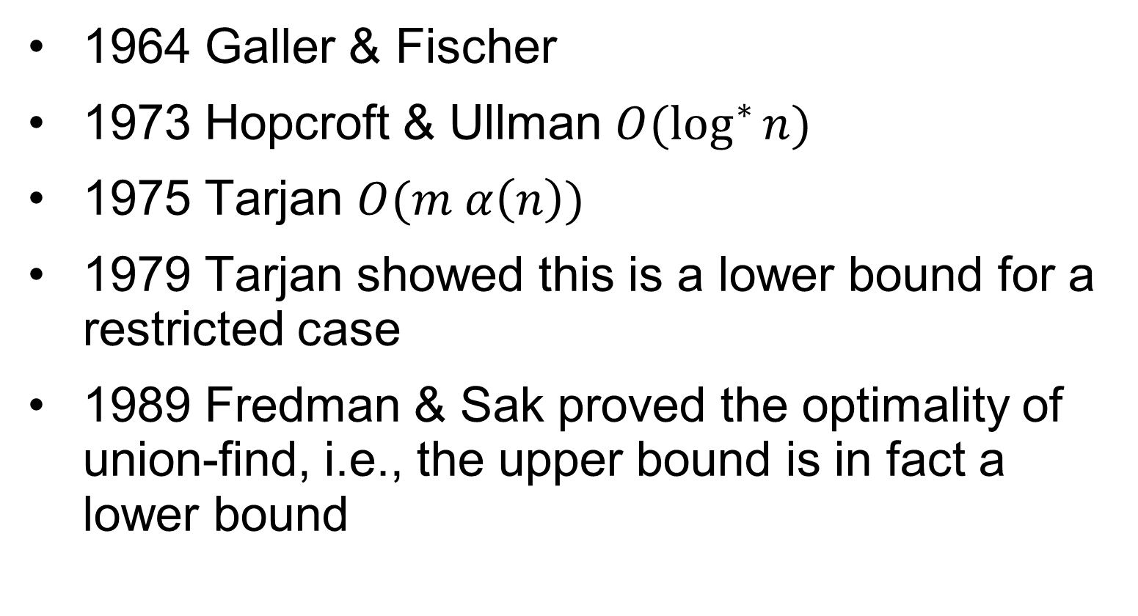
Complexity
1964 Galler & Fischer
1973 Hopcroft & Ullman $O(\log^{∗}{n})$
1975 Tarjan $O(m α\left(n\right))$
1979 Tarjan showed this is a lower bound for a restricted case
1989 Fredman & Sak proved the optimality of union-find, i.e., the upper bound is in fact a lower bound
https://en.wikipedia.org/wiki/Disjoint-set_data_structure

Slide 35
Other Minimum Spanning Tree Algorithms
Prim’s
start from one node
grow cloud by one node with smaller weight
similar to Dijkstra
Kruskal’s
start with all nodes as spanning trees
merge 2 spanning trees by one edge with lowest weight provided that does not create a cycle
Reverse-delete
start from full graph
delete edge with largest weight unless it disconnects the graph
loop till all edges considered

Slide 36
Example: reverse delete
G
G
B
8
8
4
B
4
9
E
6
9
E
1
5
F
5
6
C
3
1
F
11
C
11
2
2
7
D
H
7
D
H
A
10
A
10
G
G
8
B
8
B
4
4
E
9
E
6
5
9
6
5
F
1
F
1
3
C
3
C
11
11
2
2
7
H
7
D
H
D
A
A
10
10

Slide 37
Example (contd.)
G
B
8
4
9
E
6
1
5
F
C
11
3
2
7
D
H
A
10
G
B
8
4
9
E
6
1
5
F
C
11
3
2
7
D
H
A
10
10
https://cmps-people.ok.ubc.ca/ylucet/DS/Kruskal.html

Slide 38


Application
Notes:
11:45

Slide 39
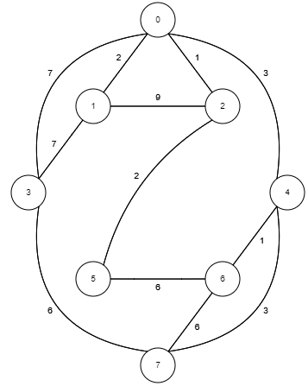

Slide 40
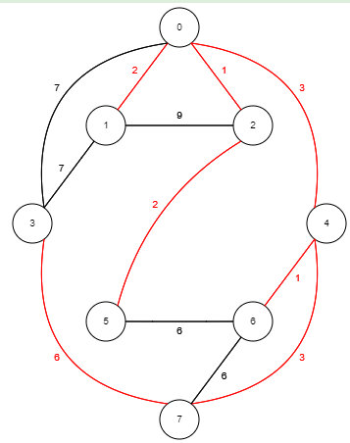

Slide 41
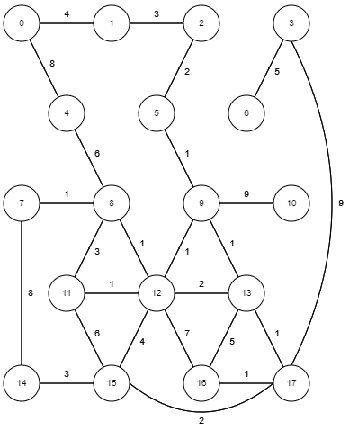

Slide 42
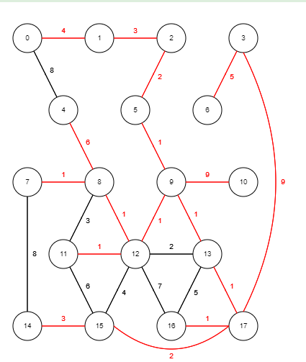

Slide 43
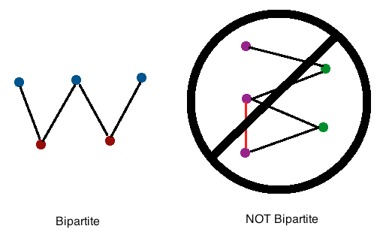
Exercise
A graph G is bipartite if its vertices can be partitioned into two sets X and Y such that every edge in G has one end vertex in X and the other in Y. Design and analyze an efficient algorithm for determining if an undirected graph G is bipartite (without knowing the sets X and Y in advance).
http://mathonline.wikidot.com/bipartite-and-complete-bipartite-graphs
Notes:
C-14.51) Hint Do a BFS search in G
C-14.51) Solution Construct a BFS search tree T for G. Place the vertices on even levels in X and the ones in odd levels in Y. Now double-check that there are no edges between a pair of vertices in X or a pair of vertices in Y. This algorithm runs in O(n+m) time.

Slide 44
Bipartite
Nonbipartite: there is an edge with 2 end points
that have the same color

Slide 45
Solution
Do a breadth-first search to construct a breadth-first search tree T
Place the vertices on even levels in X and the ones in odd levels in Y.
Now double-check that there are no edges between a pair of vertices in X or a pair of vertices in Y.
This algorithm runs in O(n+m) time.
See for example https://www.baeldung.com/cs/graphs-bipartite,
https://www.geeksforgeeks.org/bipartite-graph/

Slide 46
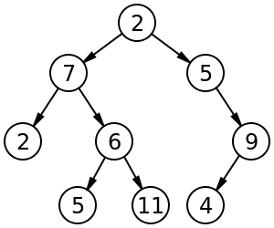
Data Structures Summary
Linear
Array, list, queue, stack, deque
Nonlinear
Binary tree, binary search tree
Priority queue
heap
Array-based, pointer-based
Adaptable priority queue
Bottom-up heap construction
Hash table
Open addressing linear probing
Separate Chaining
Skip list
Graph
Adjacency list, adjacency matrix
Union-find/disjoint-set
"Hash table 3 1 1 0 1 0 0 SP" by Jorge Stolfi - Own work. Licensed under CC BY-SA 3.0 via Commons - https://commons.wikimedia.org/wiki/File:Hash_table_3_1_1_0_1_0_0_SP.svg#/media/File:Hash_table_3_1_1_0_1_0_0_SP.svg
Shiyu Ji, CC BY-SA 4.0, via Wikimedia Commons
CC BY-SA 3.0 https://en.wikipedia.org/wiki/Skip_list#/media/File:Skip_list_add_element-en.gif

Slide 47
For next Time
iMAT in preparation for tMAT [Tuesday]

